Slide 1
Tips for Deep Learning
Instructor: Dr. Yan Yan

Slide 2

Overview
YES
Early Stopping
NO
Good Results on Testing Data?
Regularization
Dropout
YES
New Activation Function
NO
Good Results on Training Data?
Adaptive
Learning Rate

Slide 3
Tips for Deep Learning
Instructor: Dr. Yan Yan

Slide 4
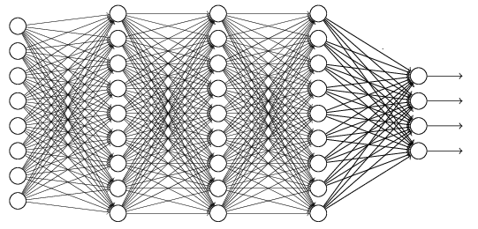
Recipe of Deep Learning
YES
Step 1: define a set of function
Step 2: goodness of function
Step 3: pick the best function
NO
Good Results on Testing Data?
Overfitting!
YES
NO
Good Results on Training Data?
Neural Network

Slide 5
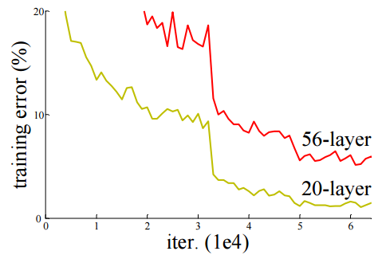
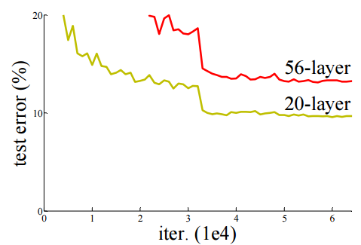

Do not always blame Overfitting
Not well trained
Overfitting?
Training Data
Testing Data
Deep Residual Learning for Image Recognition
http://arxiv.org/abs/1512.03385

Slide 6
Recipe of Deep Learning
YES
Good Results on Testing Data?
Different approaches for different problems.
YES
e.g. dropout for good results on testing data
Good Results on Training Data?
Neural Network

Slide 7
Recipe of Deep Learning
YES
Early Stopping
Good Results on Testing Data?
Regularization
Dropout
YES
New Activation Function
Good Results on Training Data?
Adaptive
Learning Rate

Slide 8
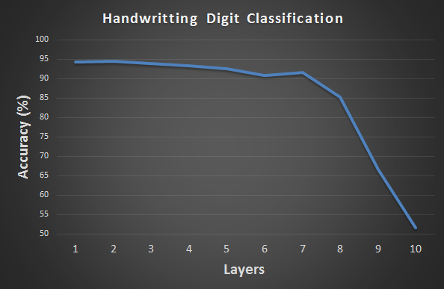
Hard to get the power of Deep …
Results on Training Data
Deeper usually does not imply better.

Slide 9
Vanishing Gradient Problem
……
y₁
……
y₂
……
……
……
……
……
……
y_{M}
Smaller gradients
Larger gradients
Learn very slow
Learn very fast
Almost random
Already converge

Slide 10
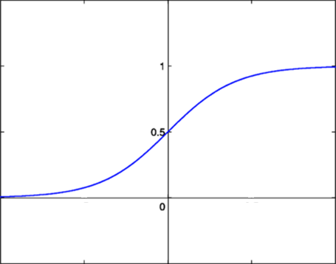
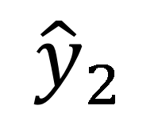

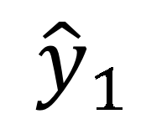
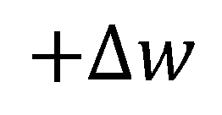
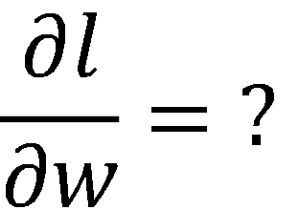
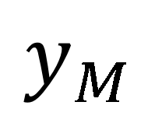

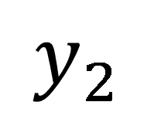
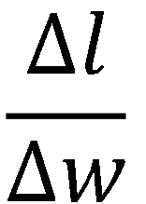
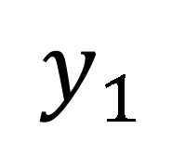
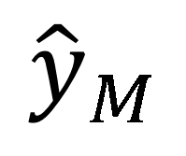
Vanishing Gradient Problem
Smaller gradients
……
$$y_{1}$$
$${\hat{y}}_{1}$$
Small output
……
$$y_{2}$$
$${\hat{y}}_{2}$$
……
……
……
……
……
$$l$$
……
$$+∆l$$
……
$$y_{M}$$
$${\hat{y}}_{M}$$
Large input
$$+∆w$$
Intuitive way to compute the derivatives …
$$\frac{∂l}{∂w}=?$$
$$\frac{∆l}{∆w}$$

Slide 11
ReLU
Instructor: Dr. Yan Yan

Slide 12

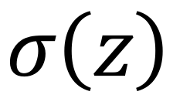
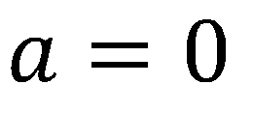
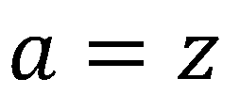

ReLU
Rectified Linear Unit (ReLU)
Reason:
1. Fast to compute
$$a$$
$$σ\left(z\right)$$
$$a=z$$
2. Biological reason
3. Infinite sigmoid with different biases
$$a=0$$
$$z$$
4. Vanishing gradient problem
[Xavier Glorot, AISTATS’11]
[Andrew L. Maas, ICML’13]
[Kaiming He, arXiv’15]

Slide 13
ReLU
$$a$$
$$a=z$$
$$a=0$$
$$z$$
0
0
0
0

Slide 14
ReLU
$$a$$
$$a=z$$
A Thinner linear network
$$a=0$$
$$z$$
Do not have smaller gradients

Slide 15
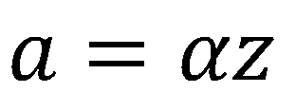
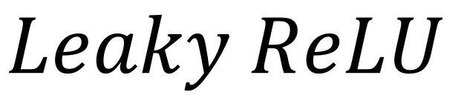
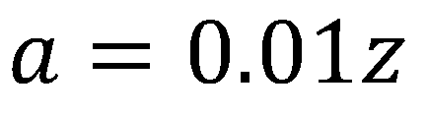
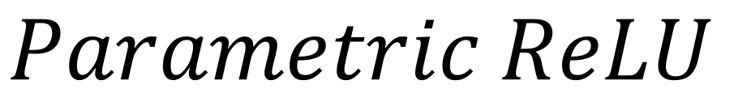
ReLU - variant
$$Leaky ReLU$$
$$Parametric ReLU$$
$$a$$
$$a$$
$$a=z$$
$$a=z$$
$$z$$
$$z$$
$$a=0.01z$$
$$a=αz$$
α also learned by gradient descent

Slide 16










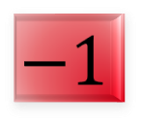

Maxout
ReLU is a special case of Maxout
Learnable activation function [Ian J. Goodfellow, ICML’13]
+
neuron
+
$$5$$
$$1$$
Input
Max
$$7$$
Max
$$2$$
+
$$7$$
+
$$2$$
+
$$−1$$
+
$$4$$
Max
$$1$$
Max
$$4$$
+
$$1$$
+
$$3$$
You can have more than 2 elements in a group.

Slide 17

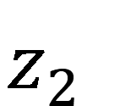


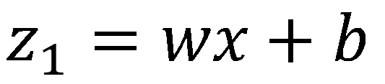
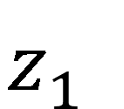

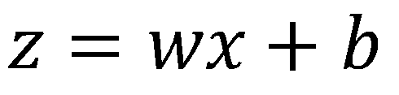
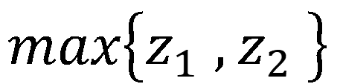
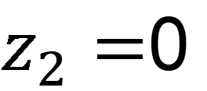
Maxout
ReLU is a special case of Maxout
+
$$z_{1}^{}$$
$$z$$
ReLU
Input
$$w$$
$$a$$
Input
$$w$$
Max
$$b$$
$$a$$
$$0$$
+
$$z_{2}^{}$$
$$max\left\{z_{1}^{},z_{2}^{}\right\}$$
$$b$$
$$0$$
$$a$$
$$a$$
$$z=wx+b$$
$$z_{1}=wx+b$$
$$x$$
$$x$$
$z_{2}=$0

Slide 18
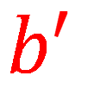

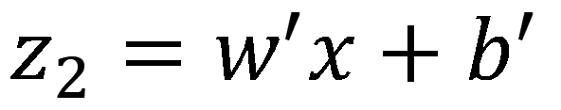
Maxout
More than ReLU
+
$$z_{1}^{}$$
$$z$$
ReLU
Input
$$w$$
$$a$$
Input
$$w$$
Max
$$b$$
$$a$$
+
$$z_{2}^{}$$
$$w^{′}$$
$$max\left\{z_{1}^{},z_{2}^{}\right\}$$
$$b$$
$$b^{′}$$
Learnable Activation Function
$$a$$
$$a$$
$$z=wx+b$$
$$z_{1}=wx+b$$
$$x$$
$$x$$
$$z_{2}=w^{′}x+b^{′}$$

Slide 19
Maxout
Learnable activation function [Ian J. Goodfellow, ICML’13]
Activation function in maxout network can be any piecewise linear convex function
How many pieces depending on how many elements in a group
2 elements in a group
3 elements in a group

Slide 20
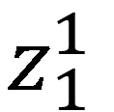
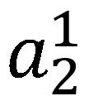
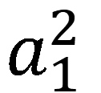
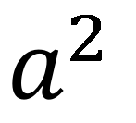

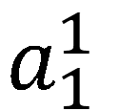
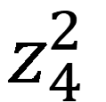
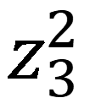
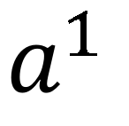
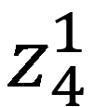
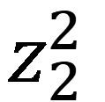
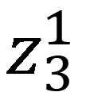
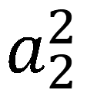
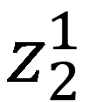
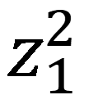

Maxout - Training
Given a training data x, we know which z would be the max
+
$$z_{1}^{1}$$
+
$$z_{1}^{2}$$
Input
Max
$$a_{1}^{1}$$
Max
$$a_{1}^{2}$$
+
$$z_{2}^{1}$$
+
$$z_{2}^{2}$$
$$max\left\{z_{1}^{1},z_{2}^{1}\right\}$$
+
$$z_{3}^{1}$$
+
$$z_{3}^{2}$$
Max
$$a_{2}^{1}$$
Max
$$a_{2}^{2}$$
$$x$$
+
$$z_{4}^{1}$$
$$a^{1}$$
+
$$z_{4}^{2}$$
$$a^{2}$$

Slide 21
Maxout - Training
Given a training data x, we know which z would be the max
Train this thin and linear network
+
$$z_{1}^{1}$$
+
$$z_{1}^{2}$$
Input
$$a_{1}^{1}$$
$$a_{1}^{2}$$
+
$$z_{2}^{1}$$
+
$$z_{2}^{2}$$
+
$$z_{3}^{1}$$
+
$$z_{3}^{2}$$
$$x$$
$$a_{2}^{1}$$
$$a_{2}^{2}$$
+
$$z_{4}^{1}$$
$$a^{1}$$
+
$$z_{4}^{2}$$
$$a^{2}$$
Different thin and linear network for different examples

Slide 22
Adaptive Learning Rate
Instructor: Dr. Yan Yan

Slide 23
Recipe of Deep Learning
YES
Early Stopping
Good Results on Testing Data?
Regularization
Dropout
YES
New Activation Function
Good Results on Training Data?
Adaptive
Learning Rate

Slide 24
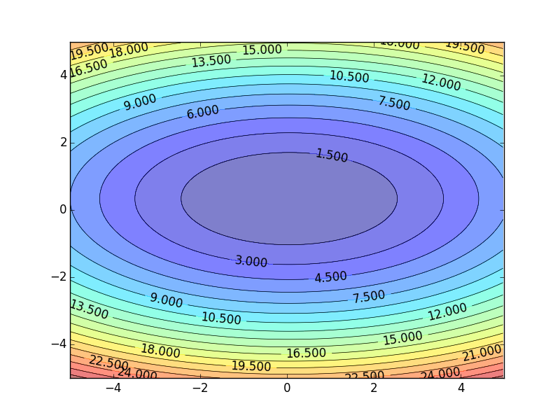
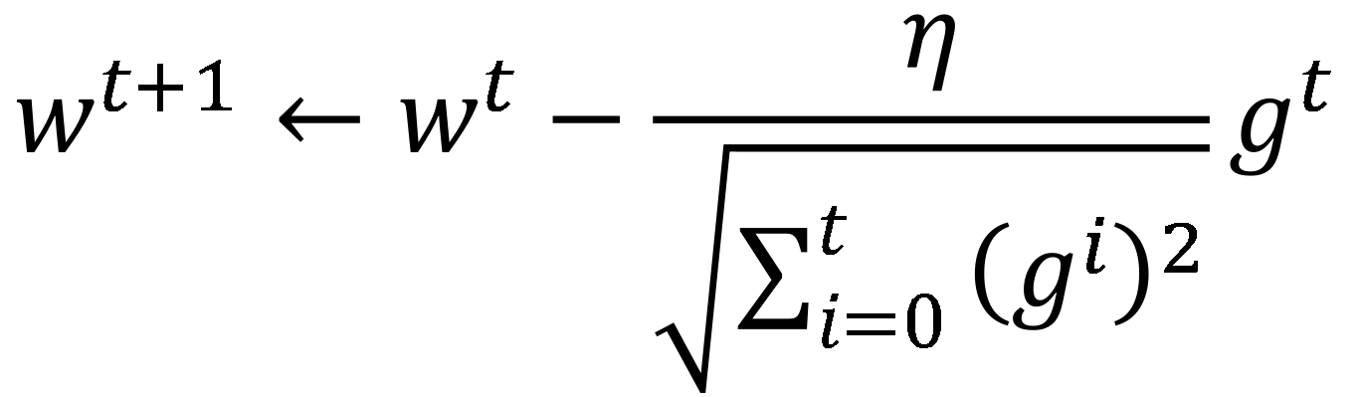
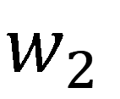
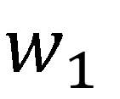
Review
Smaller Learning Rate
$$w_{2}$$
Larger Learning Rate
Adagrad
$$w_{1}$$
$$w^{t+1}←w^{t}−\frac{η}{\sqrt{\sum_{i=0}^{t}{{\left(g^{i}\right)}^{2}}}}g^{t}$$
Use first derivative to estimate second derivative

Slide 25
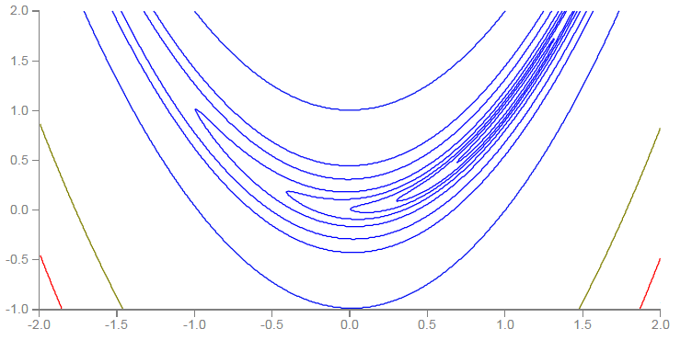
RMSProp
Error Surface can be very complex when training NN.
Smaller Learning Rate
$$w_{2}$$
Larger Learning Rate
$$w_{1}$$

Slide 26









RMSProp
$$w^{1}←w^{0}−\frac{η}{σ^{0}}g^{0}$$
$$σ^{0}=g^{0}$$
$$w^{2}←w^{1}−\frac{η}{σ^{1}}g^{1}$$
$$σ^{1}=\sqrt{{α\left(σ^{0}\right)}^{2}+\left(1−α\right){\left(g^{1}\right)}^{2}}$$
$$w^{3}←w^{2}−\frac{η}{σ^{2}}g^{2}$$
$$σ^{2}=\sqrt{{α\left(σ^{1}\right)}^{2}+\left(1−α\right){\left(g^{2}\right)}^{2}}$$
$$……$$
$$w^{t+1}←w^{t}−\frac{η}{σ^{t}}g^{t}$$
$$σ^{t}=\sqrt{{α\left(σ^{t−1}\right)}^{2}+\left(1−α\right){\left(g^{t}\right)}^{2}}$$
Root Mean Square of the gradients with previous gradients being decayed

Slide 27



Hard to find optimal network parameters
Total
Loss
Very slow at the plateau
Stuck at saddle point
Stuck at local minima
$$∂L∕∂w$$
$$≈0$$
$$∂L∕∂w$$
$$=0$$
$$∂L∕∂w$$
$$=0$$
The value of a network parameter w

Slide 28
In physical world ……
Momentum
How about put this phenomenon in gradient descent?

Slide 29
Adaptive Learning Rate
Instructor: Dr. Yan Yan

Slide 30














Review: Vanilla Gradient Descent
$$∇L\left(θ^{0}\right)$$
Start at position $θ^{0}$
$$∇L\left(θ^{1}\right)$$
Compute gradient at $θ^{0}$
$$θ^{0}$$
$$θ^{1}$$
Move to $θ^{1}$ = $θ^{0}$ - η$∇L\left(θ^{0}\right)$
$$∇L\left(θ^{2}\right)$$
Compute gradient at $θ^{1}$
$$θ^{2}$$
Gradient
Move to $θ^{2}$ = $θ^{1}$ – η$∇L\left(θ^{1}\right)$
Movement
$$∇L\left(θ^{3}\right)$$
$$θ^{3}$$
……
Stop until $∇L\left(θ^{t}\right)≈0$

Slide 31







Momentum
Movement: movement of last step minus gradient at present
Start at point $θ^{0}$
Movement v⁰=0
$$∇L\left(θ^{0}\right)$$
Compute gradient at $θ^{0}$
$$∇L\left(θ^{1}\right)$$
$$θ^{0}$$
Movement v¹ = λv⁰ - η$∇L\left(θ^{0}\right)$
$$θ^{1}$$
Move to $θ^{1}$ = $θ^{0}$ + v¹
$$∇L\left(θ^{2}\right)$$
Compute gradient at $θ^{1}$
$$θ^{2}$$
Gradient
Movement v² = λv¹ - η$∇L\left(θ^{1}\right)$
Movement
Move to $θ^{2}$ = $θ^{1}$ + v²
$$θ^{3}$$
$$∇L\left(θ^{3}\right)$$
Movement
of last step
Movement not just based on gradient, but previous movement.

Slide 32




Momentum
Movement: movement of last step minus gradient at present
Start at point $θ^{0}$
Movement v⁰=0
Compute gradient at $θ^{0}$
v^{i} is actually the weighted sum of all the previous gradient: $∇L\left(θ^{0}\right)$,$∇L\left(θ^{1}\right), …∇L\left(θ^{i−1}\right)$
Movement v¹ = λv⁰ - η$∇L\left(θ^{0}\right)$
Move to $θ^{1}$ = $θ^{0}$ + v¹
v⁰ = 0
Compute gradient at $θ^{1}$
v¹ = - η$∇L\left(θ^{0}\right)$
Movement v² = λv¹ - η$∇L\left(θ^{1}\right)$
Move to $θ^{2}$ = $θ^{1}$ + v²
v² = - λ η$∇L\left(θ^{0}\right)$ - η$∇L\left(θ^{1}\right)$
Movement not just based on gradient, but previous movement.
……

Slide 33

Momentum
Still not guarantee reaching global minima, but give some hope ……
cost
Movement =
Negative of 𝜕𝐿∕𝜕𝑤 + Momentum
Negative of $∂L∕∂w$
Momentum
Real Movement
𝜕𝐿∕𝜕𝑤 = 0

Slide 34

Adam
RMSProp + Momentum
for momentum
for RMSprop

Slide 35
Early Stopping & Regularization
Instructor: Dr. Yan Yan

Slide 36
Recipe of Deep Learning
YES
Early Stopping
Good Results on Testing Data?
Regularization
Dropout
YES
New Activation Function
Good Results on Training Data?
Adaptive
Learning Rate

Slide 37

Early Stopping
Total
Loss
Stop at here
Validation set
Testing set
Training set
Epochs
Keras:
http://keras.io/getting-started/faq/#how-can-i-interrupt-training-when-the-validation-loss-isnt-decreasing-anymore

Slide 38
Recipe of Deep Learning
YES
Early Stopping
Good Results on Testing Data?
Regularization
Dropout
YES
New Activation Function
Good Results on Training Data?
Adaptive
Learning Rate

Slide 39
Regularization
New loss function to be minimized
Find a set of weight not only minimizing original cost but also close to zero
Regularization term
Original loss
(e.g. minimize square error, cross entropy …)
L2 regularization:
(usually not consider biases)

Slide 40
Regularization
L2 regularization:
New loss function to be minimized
Gradient:
Update:
Weight Decay
Closer to zero

Slide 41
Regularization
L1 regularization:
New loss function to be minimized
Update:
Always delete
…… L2

Slide 42

Regularization - Weight Decay
Our brain prunes out the useless link between neurons.
Doing the same thing to machine’s brain improves the performance.

Slide 43
Dropout
Instructor: Dr. Yan Yan

Slide 44
Recipe of Deep Learning
YES
Early Stopping
Good Results on Testing Data?
Regularization
Dropout
YES
New Activation Function
Good Results on Training Data?
Adaptive
Learning Rate

Slide 45
Dropout
Training:
Each time before updating the parameters
Each neuron has p% to dropout

Slide 46
Dropout
Training:
Thinner!
Each time before updating the parameters
Each neuron has p% to dropout
The structure of the network is changed.
Using the new network for training
For each mini-batch, we resample the dropout neurons

Slide 47

Dropout
Testing:
No dropout
If the dropout rate at training is p%, all the weights times 1-p%
Assume that the dropout rate is 50%.
If a weight $w=1$ by training, set $w=0.5$ for testing.

Slide 48
Dropout - Intuitive Reason
My teammate will not work hard on project. I need to work hard.
When teams up, if everyone expect the partner will do the work, nothing will be done finally.
However, if you know your partner will dropout, you will do better.
When testing, no one dropout actually, so obtaining good results eventually.

Slide 49






Dropout - Intuitive Reason
Why the weights should multiply (1-p)% (dropout rate) when testing?
Training of Dropout
Testing of Dropout
Assume dropout rate is 50%
No dropout
Weights from training
$$w_{1}$$
$$0.5×$$
$$w_{1}$$
$$z^{′}≈2z$$
$$w_{2}$$
$$z$$
$$0.5×$$
$$w_{2}$$
$$z^{′}$$
$$w_{3}$$
$$0.5×$$
$$w_{3}$$
$$w_{4}$$
$$0.5×$$
$$w_{4}$$
Weights multiply 1-p%
$$z^{′}≈z$$

Slide 50
Dropout is a kind of ensemble.
Training Set
Ensemble
Set 1
Set 2
Set 3
Set 4
Network
1
Network
2
Network
3
Network
4
Train a bunch of networks with different structures

Slide 51
Dropout is a kind of ensemble.
Ensemble
Testing data x
Network
1
Network
2
Network
3
Network
4
y₁
y₂
y₃
y₄
average

Slide 52
Dropout is a kind of ensemble.
minibatch
1
minibatch
2
minibatch
3
minibatch
4
Training of Dropout
M neurons
……
2^{M} possible networks
Using one mini-batch to train one network
Some parameters in the network are shared

Slide 53
Dropout is a kind of ensemble.
Testing of Dropout
testing data x
All the weights multiply 1-p%
……
y₁
y₂
y₃
?????
average
≈
y

Slide 54


Testing of Dropout
x₁
x₂
x₁
x₂
x₁
x₂
w₁
w₂
w₁
w₂
w₁
w₂
z=w₁x₁+w₂x₂
z=w₁x₁+w₂x₂
z=w₂x₂
x₁
x₂
x₁
x₂
x₁
x₂
$$\frac{1}{2}$$
$$\frac{1}{2}$$
w₁
w₁
w₁
w₂
w₂
w₂
$$z=\frac{1}{2}w_{1}x_{1}+\frac{1}{2}w_{2}x_{2}$$
z=w₁x₁
z=0

Slide 55
Recipe of Deep Learning
YES
Step 1: define a set of function
Step 2: goodness of function
Step 3: pick the best function
NO
Good Results on Testing Data?
Overfitting!
YES
NO
Good Results on Training Data?
Neural Network

